Slide 1


Cadi Ayyad University
Start
ADVANCED LEGAL ARTICLE EXTRACTION AND CLASSIFICATION SYSTEM
Presented by
SOULALA ACHRAF
Supervised by
PROF JIHAD ZAHIR

Slide 2
Cadi Ayyad University
01
OVERVIEW
01
02
03
INTRODUCTION
PROJECT OVERVIEW
LAYOUT SEGMENTATION
04
05
08
LEGAL ARTCILE EXTRACTION
CLASSIFICATION OF ARTICLES
CHALLENGES

Slide 3
Cadi Ayyad University
02
INTRODUCTION
The central challenge tackled in this project revolves around the extraction of legal articles from a diverse range of legal documents. These documents can vary in formats, encompassing scanned papers and digitally generated PDFs. The intricacies of legal language, coupled with the heterogeneity of layouts and formatting conventions, render the direct application of traditional Optical Character Recognition (OCR) techniques a formidable task.

Slide 4
Cadi Ayyad University
03
PROBLEM STATEMENT
Accurate Legal Article Extraction: The challenge lies in developing an OCR system that accurately extracts legal articles, overcoming layout variations and complex document structures.
Precise Text Classification: In addition to extraction, precise classification of extracted articles into zones and non-zones is essential for legal professionals' efficient analysis.
Maritime Law Domain: Our project specifically targets maritime law, aiming to enhance legal document analysis and research in this domain.

Slide 5

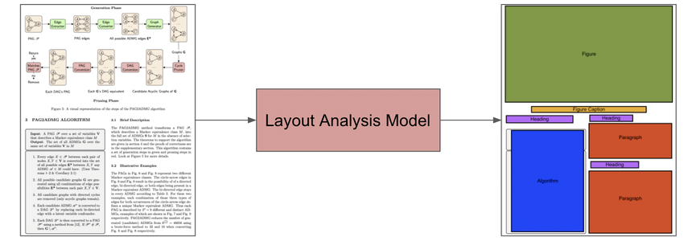
Cadi Ayyad University
Thynk University
4
LAYOUT SEGMENTATION
This pivotal stage of our project involves the meticulous identification and categorization of various layout elements within legal documents. Building upon our previously established OCR foundation, we'll explore how the annotation capabilities of Label Studio empower us to create a precise dataset. This dataset forms the bedrock for fine-tuning our layout segmentation model, equipping it to accurately dissect paragraphs, titles, figures, tables, and lists.

Slide 6
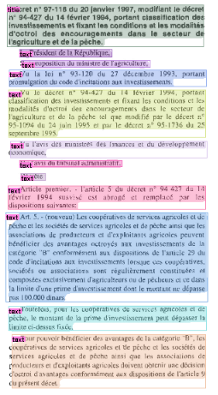
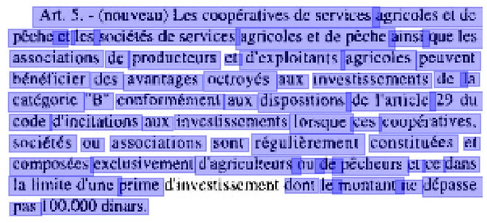
Cadi Ayyad University
| Business Marketing |
5
LEGAL ARTCILE EXTRACTION
Objective n° 1
Objective n° 2
Objective n° 3
Segment paragraphs
apply word segmentation
extract articles
Art. 5.- - (nouveau) Les coopératives de services agricoles Cl dc peche ct les sociélés de services agriçoles et de pèche ainsi que les associations de productcurs ct d'exploitants agricoles pouvent bénéficier des avantages octroyés aux investissements de la catégoric "B" conformément aux dispositions de l'anicle 29 du code d'incilations aux investissements lorsque ces coupératives. sociétés ou associations sont régulèrement constituées et composées exclusivement d'agricukeurs ou de pècheurs cl ce dans la limile d'une prime dinvestissement dont le muntant Ie dépasse pas 100.000 dinars.

Slide 7
Cadi Ayyad University
6
IMPLEMENTATION
PHASE 01:
LAYOUT SORTING
PHASE 02:
ARTICLE IDENTIFICATION
PHASE 03:
ARTICLE EXTRACTION
For Each Page Layout:
Identify Article Start Indices
Identify Article End Indices
For Each Article:
Extract Article Layouts
Extract Article Content
If Article Content Exists:
Add Extracted Content to Article Data
Input: Layout Segmentation Results with Bounding Box Information
Output: Sorted Layouts

Slide 8
Cadi Ayyad University
7
EVALUATION
Our articles extraction process underwent evaluation across a diverse set of 30 PDF documents, encompassing varying layouts and content structures. The aggregated results showcased a solid performance, with an average precision of around 0.89, ensuring accuracy in the extracted articles. The average recall stood at about 0.88, effectively capturing relevant content. The F1-score, an amalgamation of precision and recall, averaged approximately 0.88, balancing accuracy and comprehensiveness adeptly. These metrics underscore the reliability of our extraction approach.

Slide 9

Cadi Ayyad University
8
ARTICLES CLASSIFICATION
DATA SOURCE
The training data for maritime zone classification consisted of a carefully curated dataset of legal articles. To enhance the model's performance, I integrated active learning, which dynamically expanded the dataset. Instances with prediction confidences below the 0.9 threshold were identified through active learning.
By including these instances, human annotators could assess and label them, effectively adding valuable examples to the training data. This approach enriched the dataset, refining the model's ability to classify maritime zones accurately.

Slide 10
Cadi Ayyad University
9
PROCESS
ARTICLES PREPROCESSING
Preprocessing involves vital transformations, like text normalization, punctuation removal, and tokenization. These steps refine article data, ensuring optimal feature extraction and accurate classification.
MODELING
Modeling employs diverse techniques like XGBoost, SVM, Random Forest, and BERT to predict maritime zones. Their ensemble enhances accuracy. Active learning flags instances with low prediction confidence for human annotation, refining the model iteratively.

Slide 11
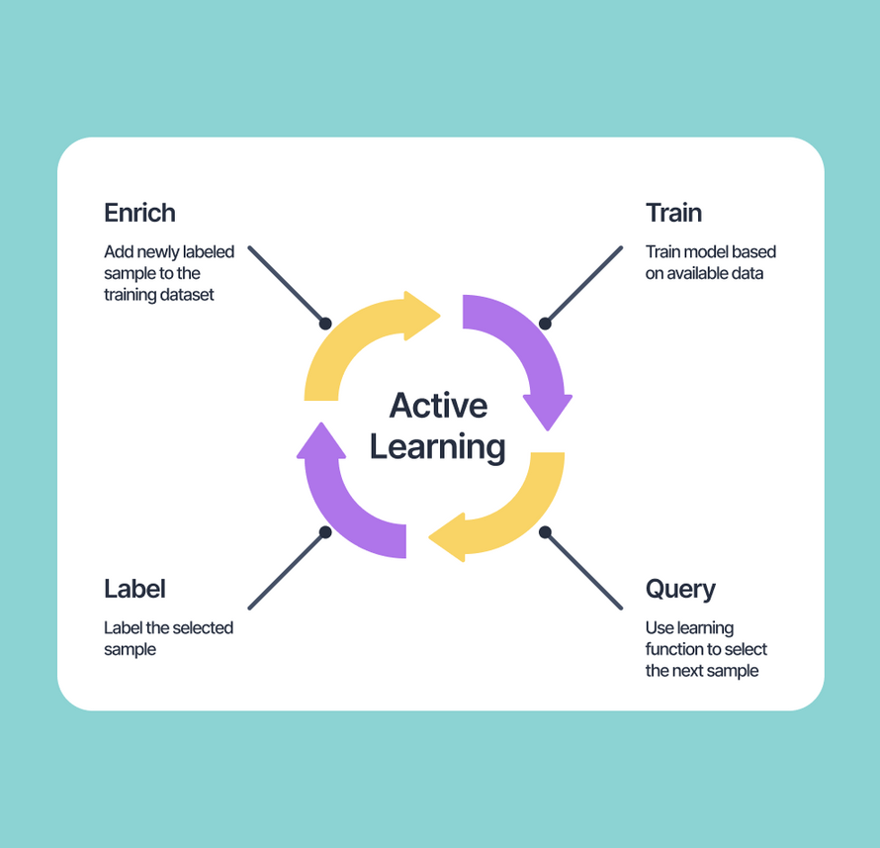
Cadi Ayyad University
10
ACTIVE LEARNING
Active learning optimizes classification by involving human input on uncertain predictions. For the articles extracted, active learning was applied to supplement the initial dataset.
When the model's confidence falls below the active learning threshold of 0.9, instances are flagged for human review. This iterative process refines the model, ensuring more accurate maritime zone classification while leveraging additional data.

Slide 12
Cadi Ayyad University
11
EVALUATION
 | Approach | Precision | Recall | F1-score
 | Approach | Precision | Recall | F1-score
Before Active learning | ML | 92% | 89% | 90%
Before Active learning | DL | 85% | 84% | 84%
Before Active learning | DL | 85% | 84% | 84%
Before Active learning | DL | 85% | 84% | 84%
After Active learning | ML | 92% | 91% | 91%
After Active learning | DL | 87% | 85% | 85%
After the active learning process, a noticeable boost in model efficacy was observed. Both precision and recall exhibited substantial gains, highlighting the model's increased ability to correctly classify maritime zones while minimizing false positives and negatives.

Slide 13
Cadi Ayyad University
12
CHALLENGES
Content Structure Variability:
Challenge: Legal articles often have diverse content structures, with variations in text arrangement, formatting, and document organization.
Impact: The system may struggle to identify and extract content consistently when faced with non-standardized structures.
Article Shape and Declaration:
Challenge: Legal documents may contain articles presented in unconventional shapes or formats. The declaration of articles may not follow a standard pattern.
Impact: Extraction accuracy may decrease if the system is not adapted to recognize and interpret diverse article shapes and declarations.
PDF Quality Issues:
Challenge: Poor-quality PDFs, with low resolution, blurred text, or distorted layout, pose challenges for accurate content extraction.
Impact: OCR (Optical Character Recognition) accuracy can be compromised, leading to errors in text extraction and interpretation.

Slide 14
Cadi Ayyad University
13
CHALLENGES
Splitted Content Handling:
Challenge: Legal articles may span multiple pages, leading to content splitting. Handling continuity across pages is crucial for accurate extraction.
Impact: Inability to address content continuity challenges may result in incomplete extractions or misinterpretation of article boundaries.
Mixed Content Types:
Challenge: Legal documents often contain a mix of text, tables, figures, and lists. Recognizing and appropriately handling diverse content types is essential.
Impact: Inability to differentiate and process various content types may result in misinterpretation or loss of critical information.

Slide 15
THANK YOU!

